Slide 1

Solar Energy Co.
A Data-Driven Marketing Strategy
Dardeep Somel

Slide 2
Solar Energy Co.
A Data-Driven Marketing Strategy
Dardeep Somel

Slide 3
Objectives
• Provide a data-driven recommendation
• Which city in the US?
Focus: Highest potential return on investment for Consumers

Slide 4
The Data
Data Sources and Features
Solar data
Demographic Data
Energy Data

Slide 5
Process
Data Collection
Data Wrangling
EDA
Time Series Modeling
City Selection

Slide 6

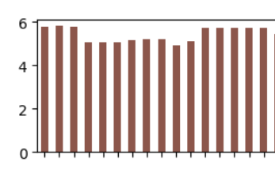

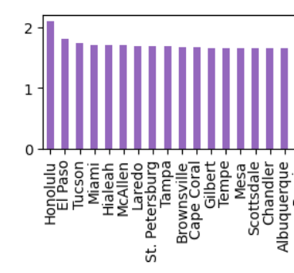
Solar Data
Time Frame:
January 2021 - March 2024
Key Features
All-Sky Surface Shortwave Downward Irradiance
All-Sky Surface Shortwave Downward Irradiance

Slide 7
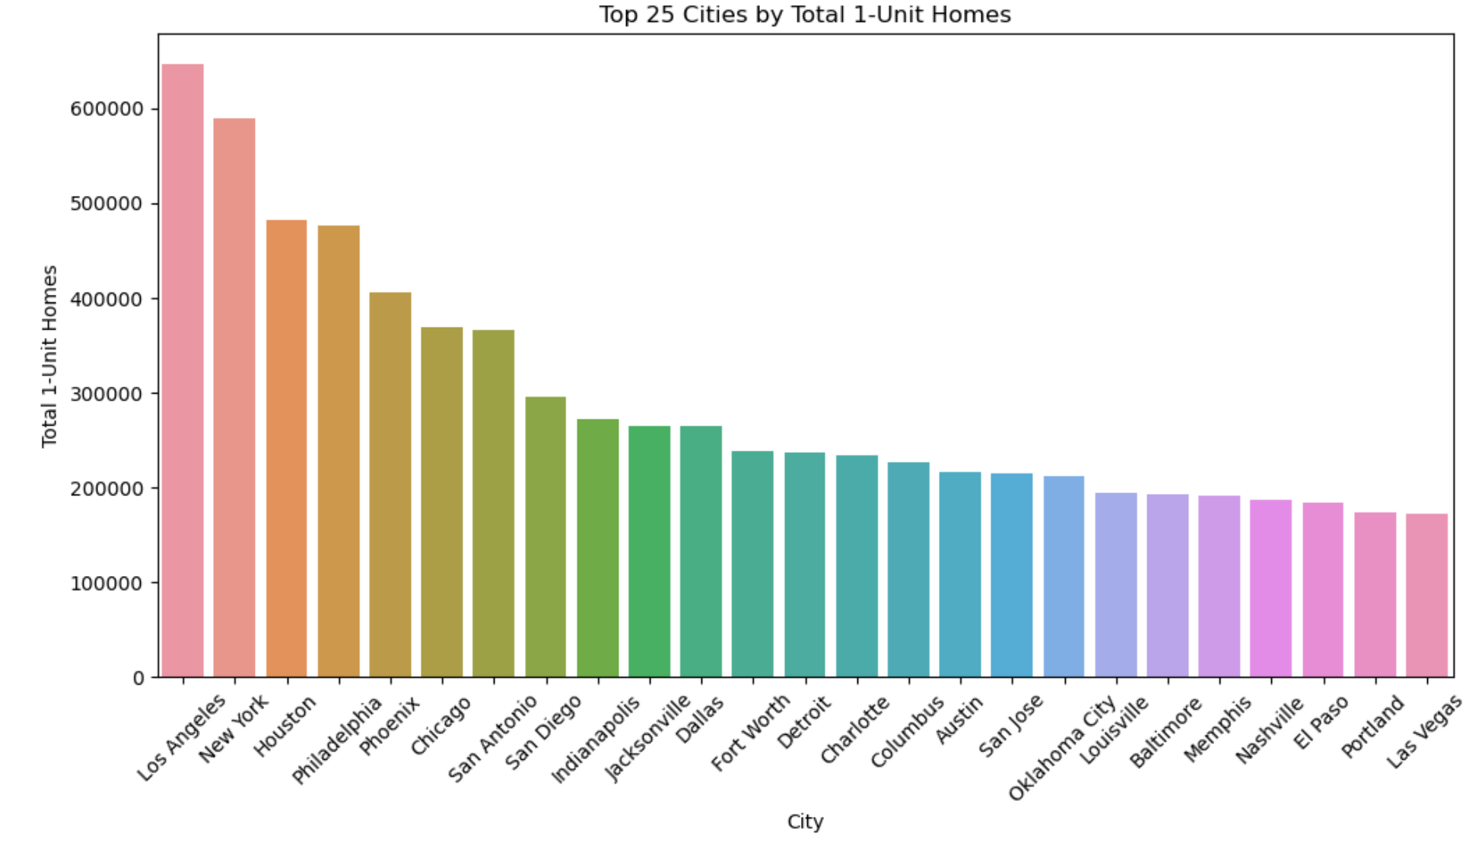
Cenus Data
Purpose: To identify market size and potential customer base
Coverage: Top 200 U.S. Cities by Population
Key Features
Total Population
Median Household Income
Median Home Value
Total 1-unit Homes

Slide 8
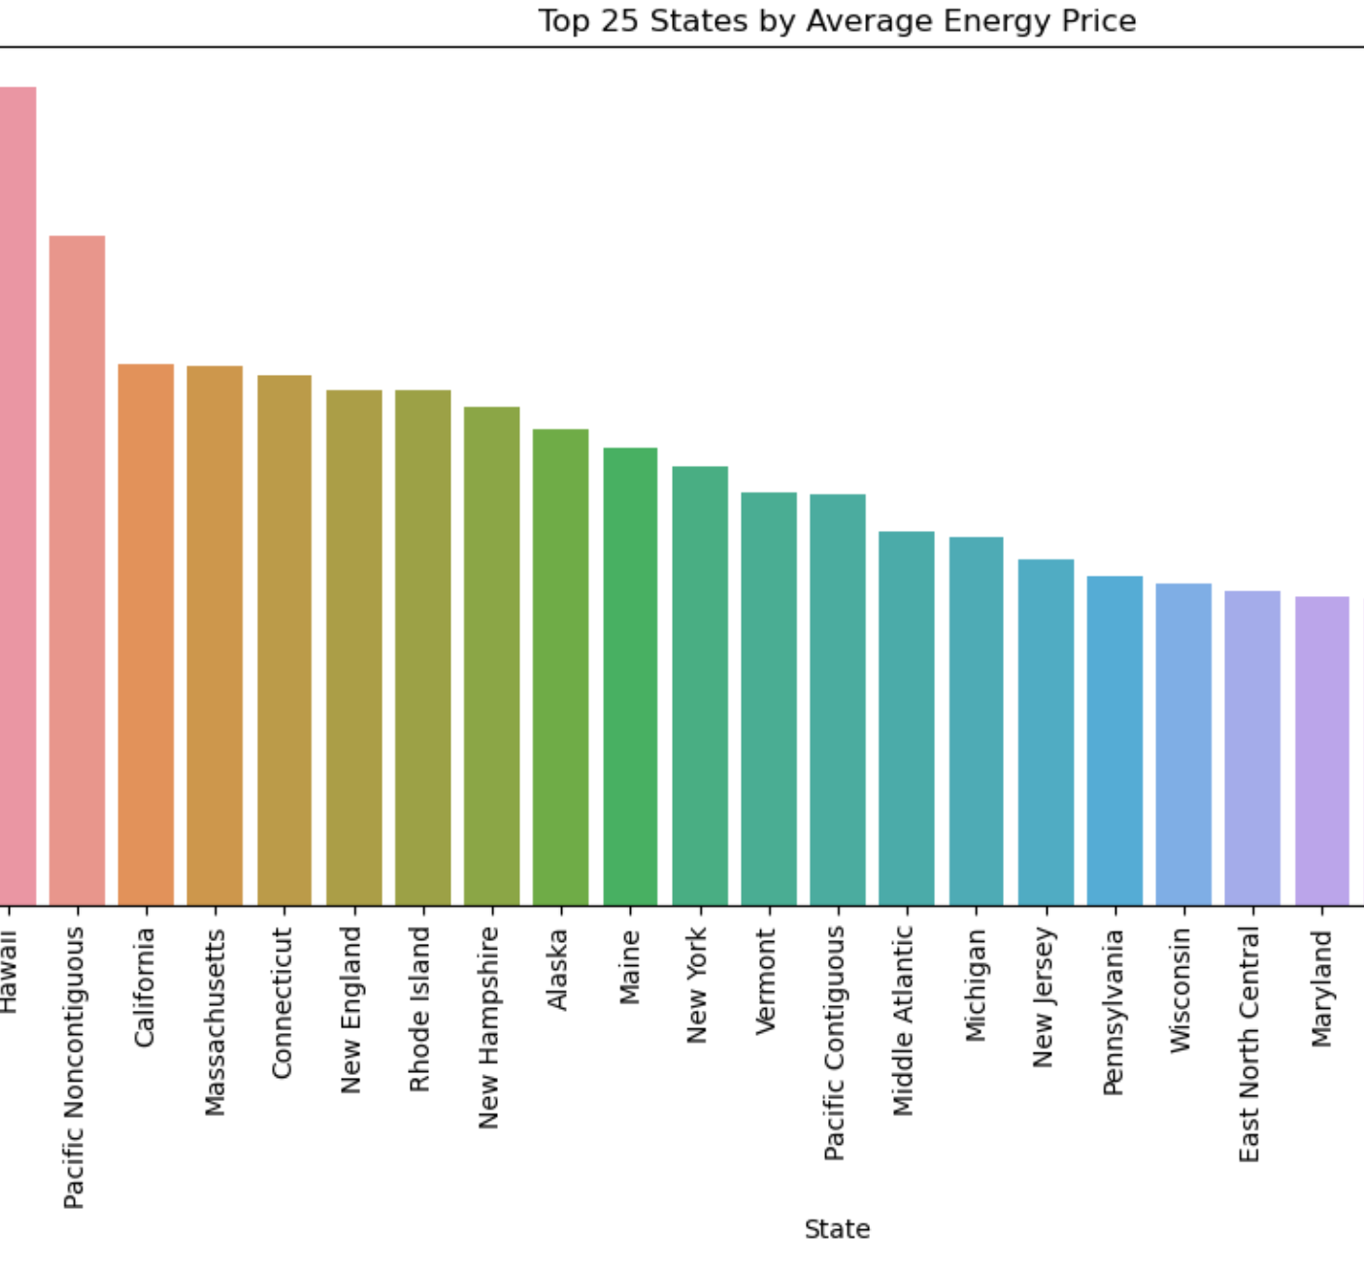
Energy Information Data
Purpose: To evaluate energy costs and potential savings from solar adoption
State-level data for all U.S. states
Key Features
Average Electricity Price (cents per kWh)
Total Electricity Sales (million kWh)

Slide 9
Modeling - Time Series Forecasting
Models Considered:
ARIMA
VAR
LSTM
Key Metrics:
MAE
MSE
R-squared for model evaluation
RMSE

Slide 10

Scoring System: Weighted Model
High solar irradiance levels and favorable demographics significantly boost city scores
Cities with high electricity prices present more opportunities for solar adoption
Adjusting weights can significantly impact city rankings, allowing for targeted analysis

Slide 11
Recommendation System

Slide 12
Results and Conclusion
• Sunnyvale, California is #1
• The model can be adjusted
• The results provide a data-driven recommendation

Slide 13
Challenges
• NASA Power API: Required latitude and longitude for each city, took approximately 7 hours to complete, and had frequent timeouts.
• Missing UV Index Data: 5338 missing entries for ALLSKY_SFC_UV_INDEX resolved using linear regression with high accuracy (R2: 0.9986).
• ARIMA and VAR modeling challenges: Encountered issues with stationarity and negative forecasts, resolved by switching to LSTM models.
LSTM Model – Low accuracy

Slide 14
Future Roadmap
Expand Data Sources
Enhance Model Capabilities
Refine Scoring System
Automation and Scalability
Pilot Testing and Validation

Slide 15

Questions?
Thank you for your attention.

